Slide 1

ECE 1710: Power Distribution Engineering and Smart Grids
Lecture 5
Dr. Robert Kerestes
University of Pittsburgh
Swanson School of Engineering
Department of Electrical and Computer Engineering
Notes:
Instructions for editing school and department titles:
Select from menu: View > Master > Slide Master
Click on each text area you wish to edit. Text will become editable.

Slide 2
Outline
Lecture Outline
Module #1: Cost and construction of overhead lines
Module #2: Conductors
Module #3: Untransposed Distribution Lines
Module #4: Carson’s Equations

Slide 3
Learning Objectives
Learning Objectives:
State facts about cost and construction of overhead lines
Identify common types of conductor
Read conductor data tables and identify important quantities
Calculate primitive self and mutual impedances for untransposed overhead lines by employing Carson’s equations.

Slide 4
Cost and Construction of Overhead Lines

Slide 5
Cost and Construction of Overhead Lines
Overhead lines feed many of the distribution customers that are serviced and can be found on streets, alleys, through woods and backyards.
Overhead lines are exposed to trees and animals, to wind and lightning, and to cars and kites, they are a critical component in the reliability of distribution circuits.
Many of the lines that exist in the City of Pittsburgh and are owned by Duquesne Light Company are overhead lines.

Slide 6
Cost and Construction of Overhead Lines
Normally there is one circuit (single-, two-, or three-phase) per pole, but some utilities use more than one.
For a three-phase circuit, the most common structure is an 8 or a 10 foot crossarm on a pole.
Armless constructions are also widely found where fiberglass insulator standoffs or post insulators are used in a tighter configuration
Utilities normally use 30- to 45-ft poles, set 6 to 8 ft deep.
Vertical construction is also occasionally used. Span lengths vary from 100 to 150 ft in suburban areas to as much as 300 or 400 ft in rural areas.

Slide 7
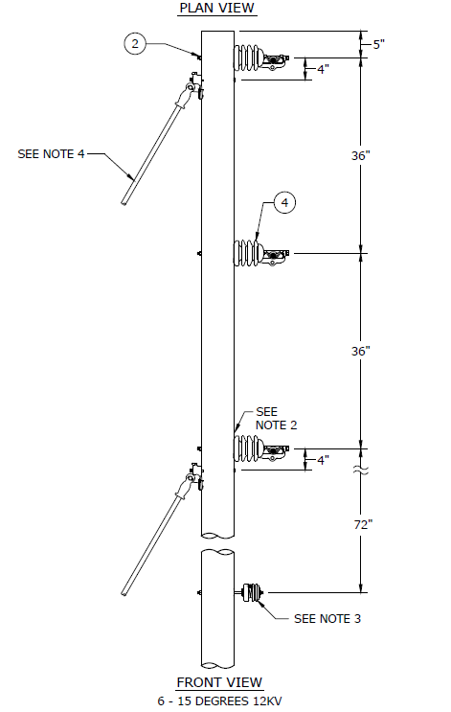
Cost and Construction of Overhead Lines
Drawing of a vertically constructed line provided by Duke Energy [1]

Slide 8
Cost and Construction of Overhead Lines
Distribution circuits normally have an underbuilt neutral
the neutral acts as a safety ground for equipment and provides a return path for unbalanced loads and for line-to-ground faults.
The neutral is 3 to 5 ft below the phase conductors. The energized cables are on top to protect linemen who climb the poles.
Utilities in very high lightning areas may run the neutral wire above the phase conductors to act as a shield wire.
Some utilities also run the neutral on the crossarm.
Secondary circuits are often run under the primary. The primary and the secondary may share the neutral, or they may each have their own neutral.
Many electric utilities share their space with other utilities; telephone or cable television cables may run under the electric secondary.

Slide 9
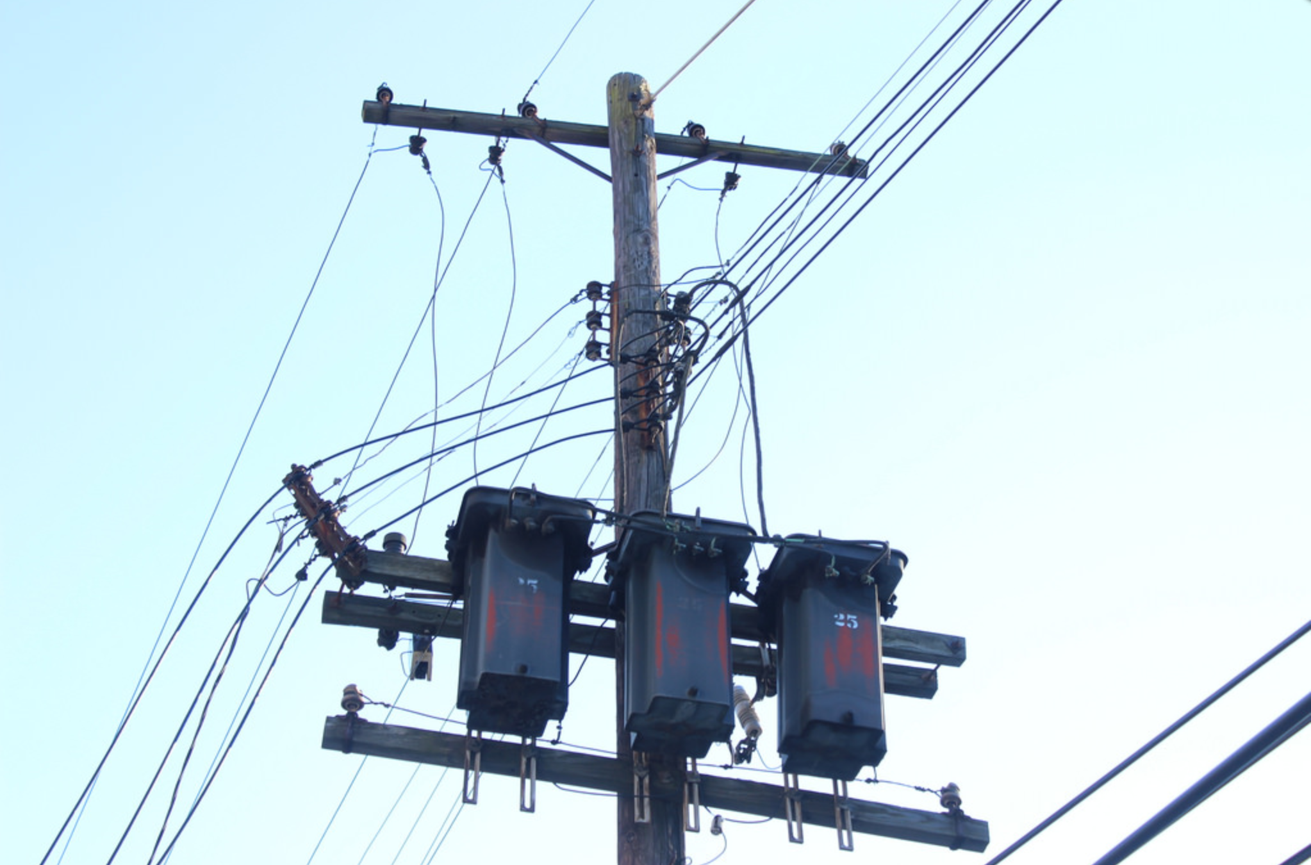
Cost and Construction of Overhead Lines
4.16 kV, Duquesne Light, North Versailles, PA

Slide 10
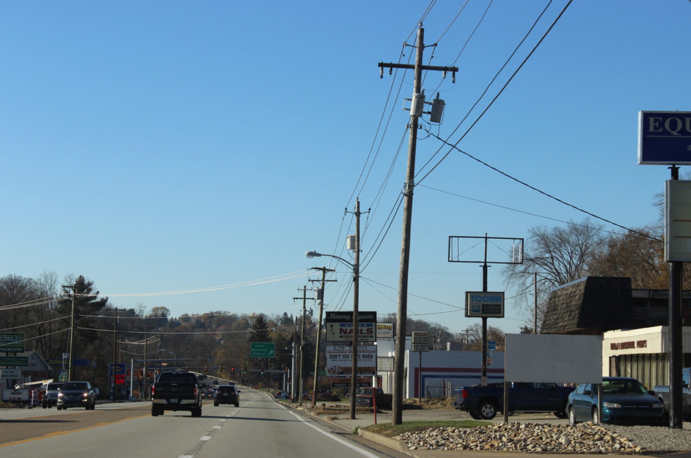
Cost and Construction of Overhead Lines
12.47 kV West Penn Power, Irwin, PA

Slide 11
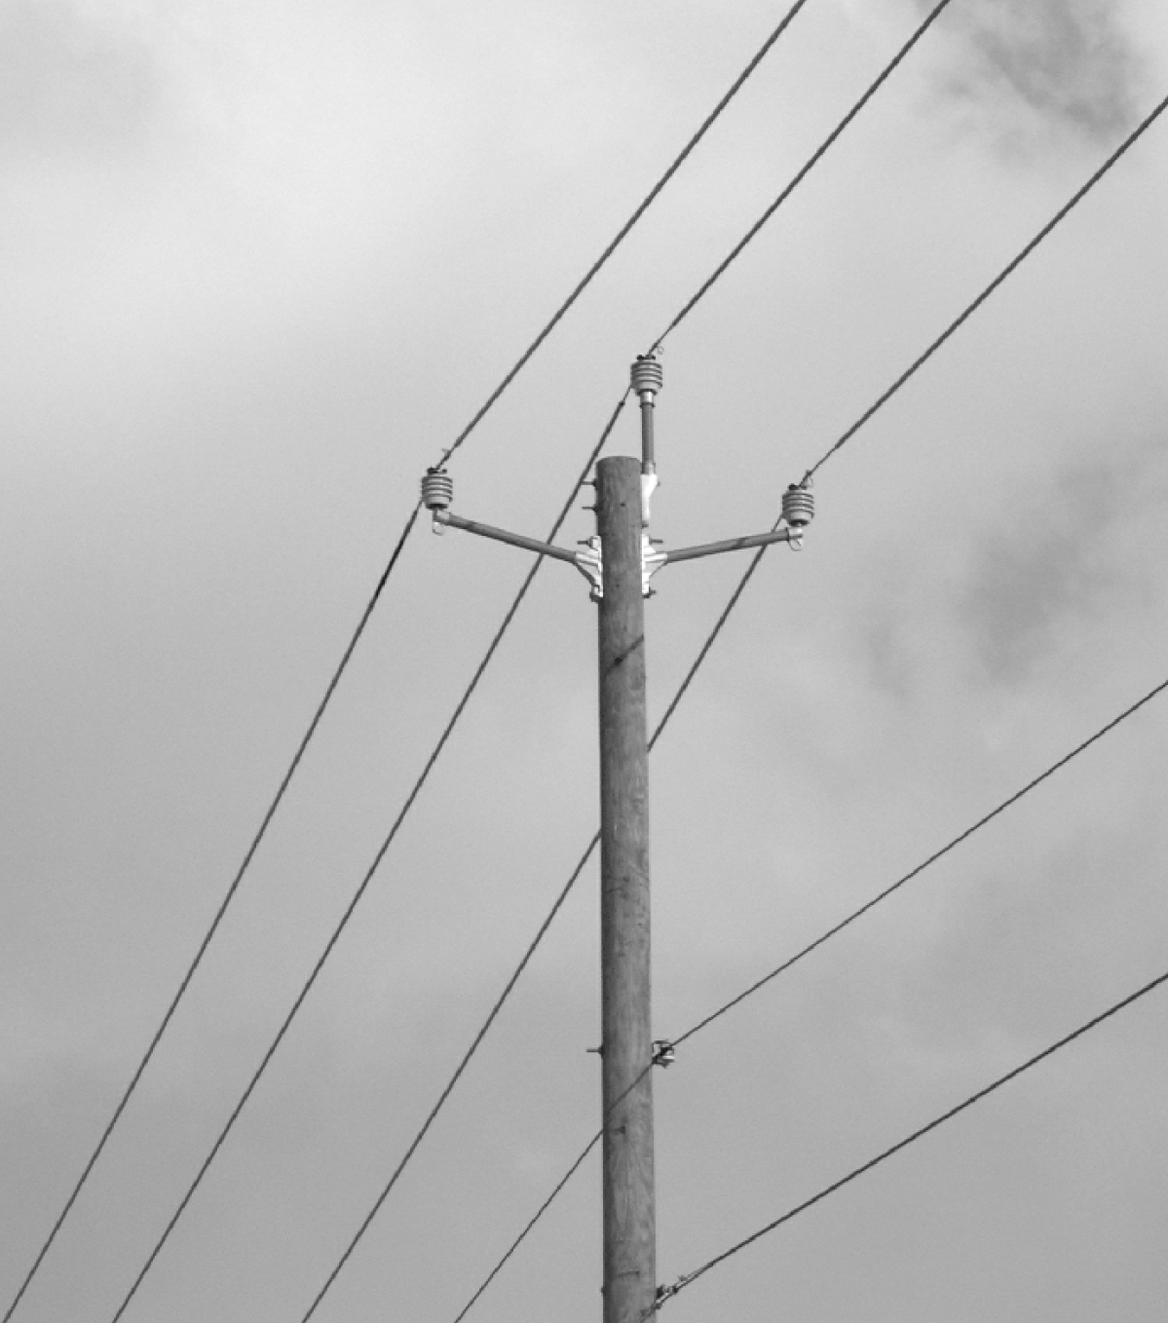
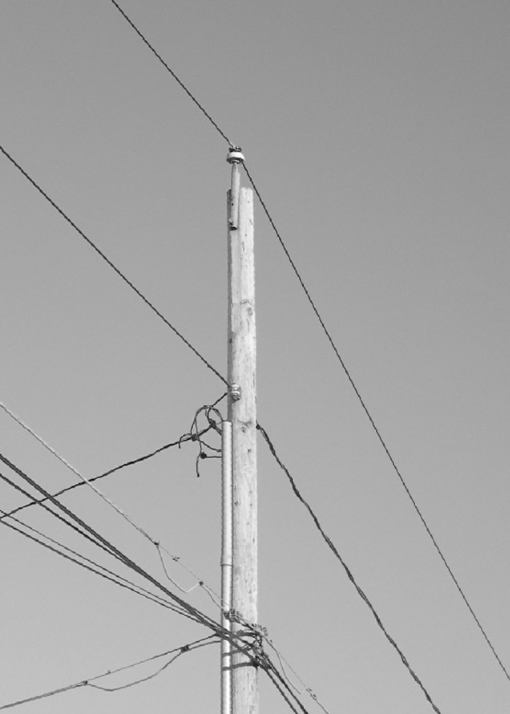
Cost and Construction of Overhead Lines
34.5 kV armless construction with covered wire [1]
7.2 kV, single-phase, line-to-ground [1]

Slide 12
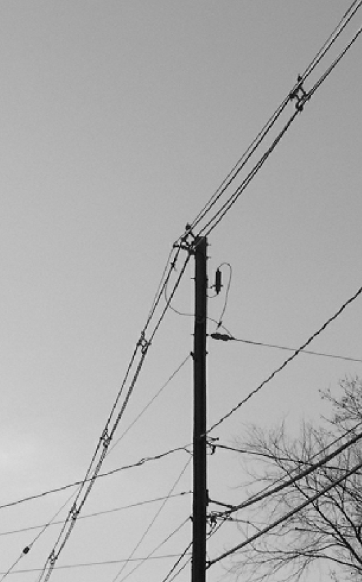
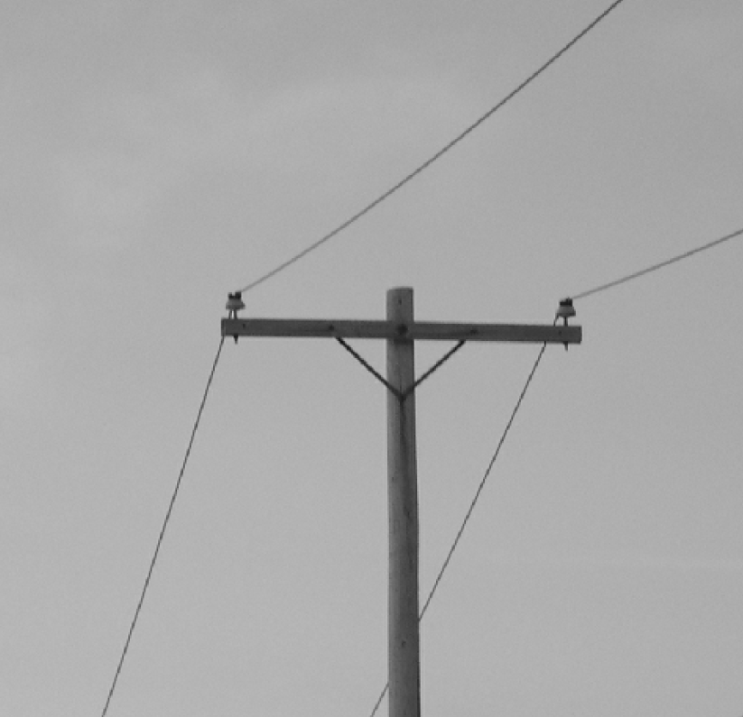
Cost and Construction of Overhead Lines
Single-phase, 4.8-kV circuit [1]
13.2-kV spacer cable [1]

Slide 13
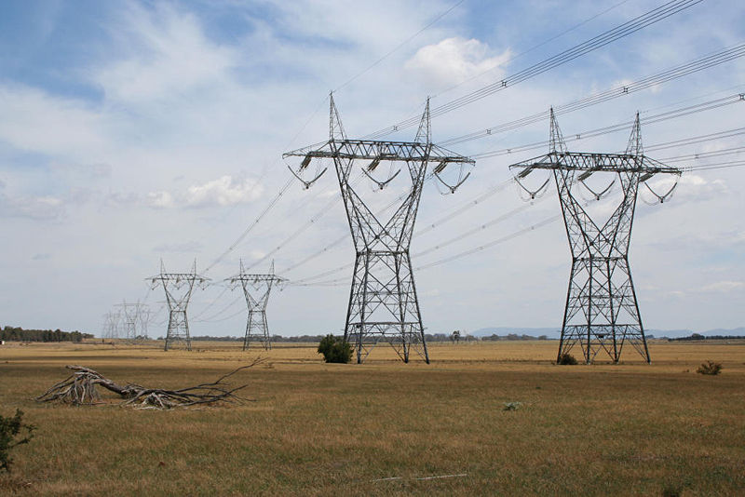
Cost and Construction of Overhead Lines
500 kV Lines in Australia (not distribution level) [3]

Slide 14
Cost and Construction of Overhead Lines
Distribution poles are constructed of:
Wood (this is the most common construction type).
Treated wood is often used because it lasts a long time and is easy to climb and attach equipment to and also augments the insulation between the energized conductors and ground.
Steel
Concrete
Fiberglass
Conductors are primary made of aluminum
Insulators are pin type, post type or suspension, and made of either porcelain or polymer.

Slide 15
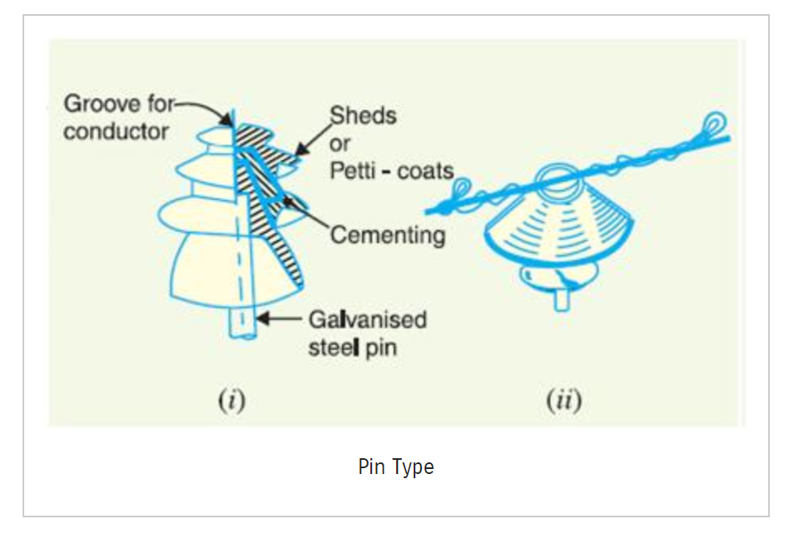
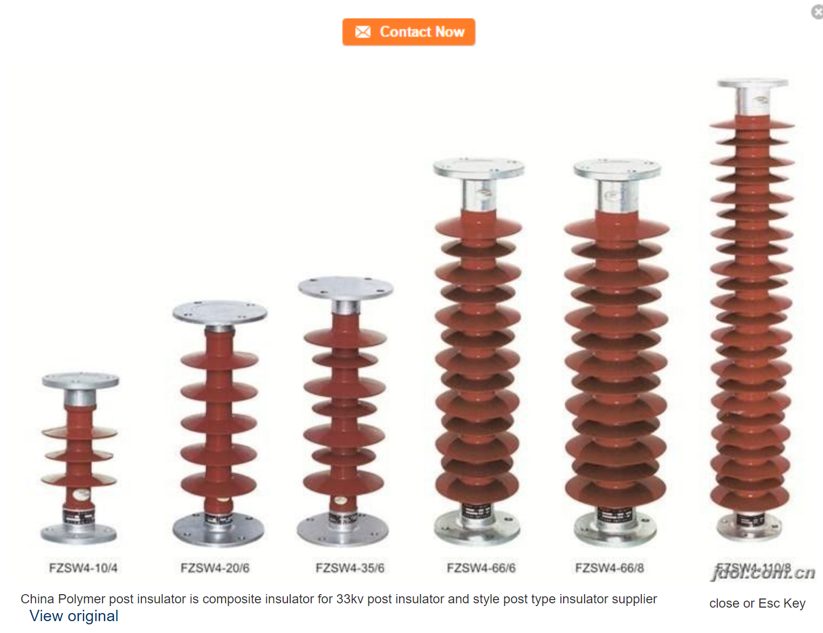
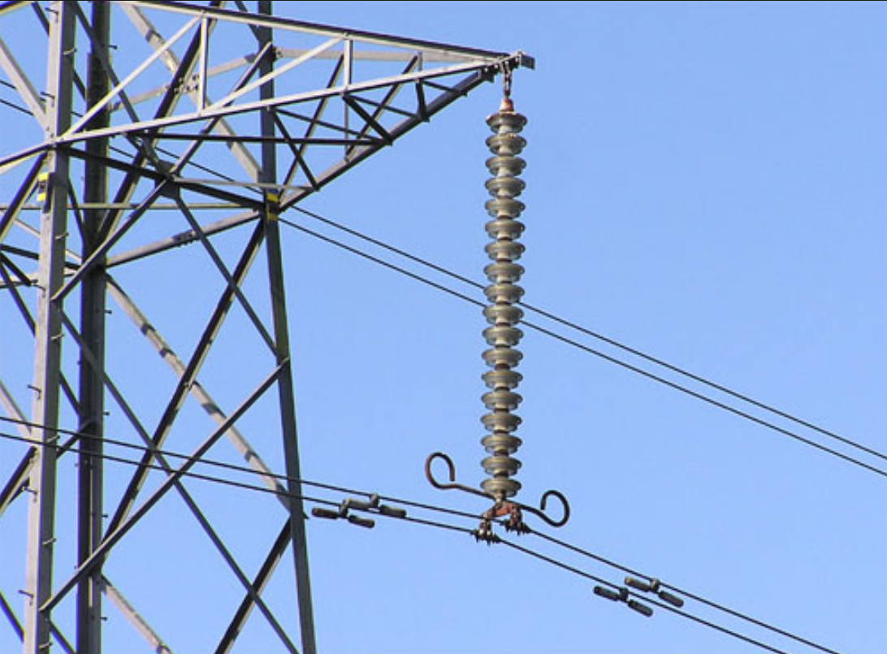
Cost and Construction of Overhead Lines

Slide 16
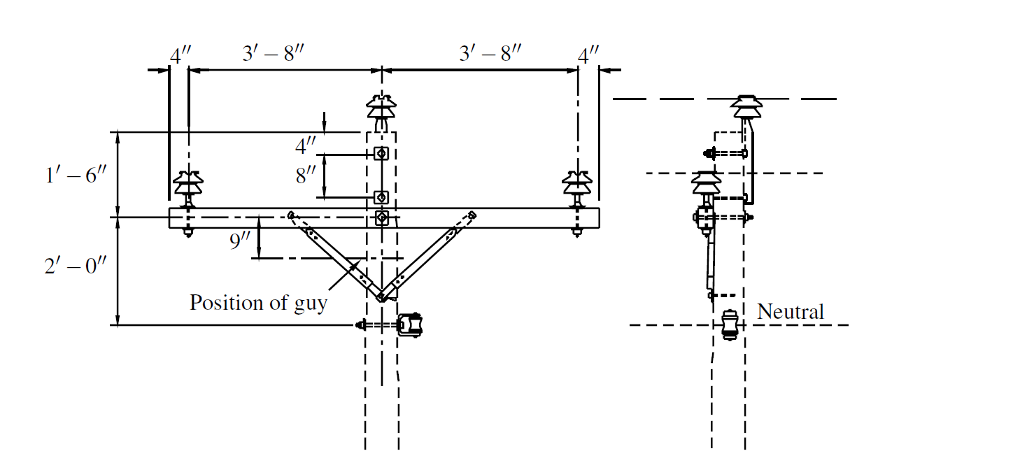
Distribution Line Construction
Example of a crossarm construction

Slide 17
Cost and Construction of Overhead Lines
Overhead line construction costs can range from $10,000/mile to $250,000/mile depending on the circumstances:
How open the land is
Natural objects (rocks, trees…etc.)
Single-, two- or three-phase
Suburban three-phase mains usually cost $60,000/mile to $150,000/mile
Suburban single-phase laterals usually cost $40,000/mile to $75,000/mile.
Rural construction is generally less expensive than urban construction.

Slide 18
Cost and Construction of Overhead Lines
Example: The following statements are true about distribution lines (select all that apply)
Secondary circuits can run under primary circuits on the same pole
Neutral conductors are always placed under the energized conductors to ensure linemen safety
Neutral conductors play an essential role in the protection of equipment during faults.
Poles should not be made of metal because the poles themselves could conduct electricity

Slide 19
Conductors

Slide 20
Conductors
A wire is metal drawn or rolled to long lengths, normally understood to be a solid wire. Wires may or may not be insulated.
A conductor is one or more wires suitable for carrying electric current.
Note: Often times wire is used to mean conductor

Slide 21
Conductors
Most conductors are either aluminum or copper.
Utilities use aluminum for almost all new overhead installations.
Aluminum is lighter and less expensive for a given current-carrying capability.
Copper was installed more in the past, so significant lengths of copper are still in service on overhead circuits.

Slide 22
Conductors
Aluminum for power conductors is alloy 1350, which is 99.5% pure and has a minimum conductivity of 61.0% IACS (5.8001 x 10⁷ S/m)
Pure aluminum melts at 660˚C. Aluminum starts to anneal (soften and lose strength) above 100˚C
It has good corrosion resistance
When exposed to the atmosphere, aluminum oxidizes, and this thin, invisible film of aluminum oxide protects against most chemicals, weathering conditions, and even acids. Aluminum can corrode quickly through electrical contact with copper or steel. This galvanic corrosion (dissimilar metals corrosion) accelerates in the presence of salts.

Slide 23
Conductors
Several variations of aluminum conductors are available, and are covered over the next few slides.

Slide 24
Conductors
AAC — all-aluminum conductor:
Aluminum grade 1350-H19 AAC has the highest conductivity-to-weight ratio of all overhead conductors.

Slide 25
ACSR — aluminum conductor, steel reinforced:
Because of its high mechanical strength-to-weight ratio, ACSR has equivalent or higher ampacity for the same size conductor (the kcmil size designation is determined by the cross-sectional area of the aluminum; the steel is neglected).
The steel adds extra weight, normally 11 to 18% of the weight of the conductor. Several different stranding's are available to provide different strength levels.
Common distribution sizes of ACSR have twice the breaking strength of AAC. High strength means the conductor can withstand higher ice and wind loads.
Trees are less likely to break this conductor.

Slide 26
Conductors
AAAC — all-aluminum alloy conductor:
This alloy of aluminum, the 6201-T81 alloy, has high strength and equivalent ampacities of AAC or ACSR.
AAAC finds good use in coastal areas where use of ACSR is prohibited because of excessive corrosion.

Slide 27
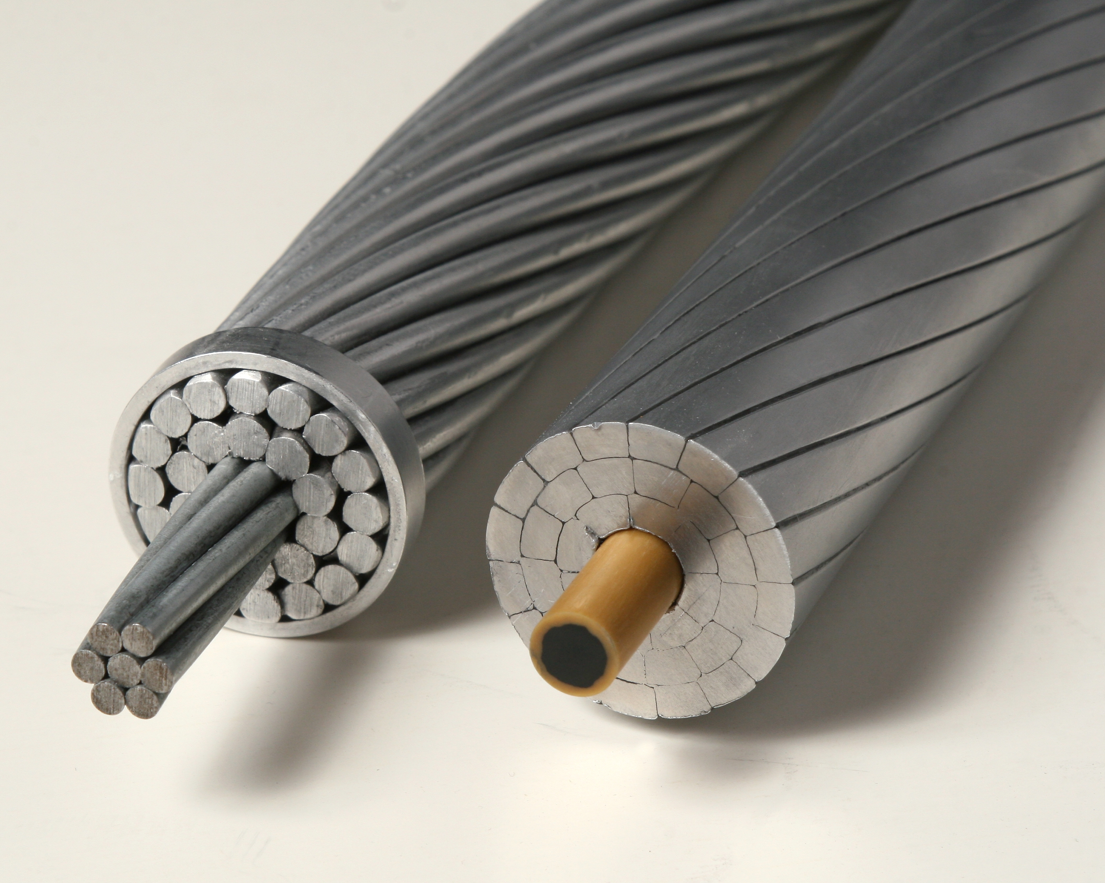
ACSR conductor (left) and AAAC conductor (right) [1]

Slide 28
Conductors
ACAR — aluminum conductor, alloy reinforced:
Strands of aluminum 6201-T81 alloy are used along with standard 1350 aluminum.
The alloy strands increase the strength of the conductor. The strands of both are the same diameter, so they can be arranged in a variety of configurations.

Slide 29
Conductors
The characteristics of conductors are readily available and can be used to develop impedance models for lines. AAC characteristics can be seen on the next slide

Slide 30
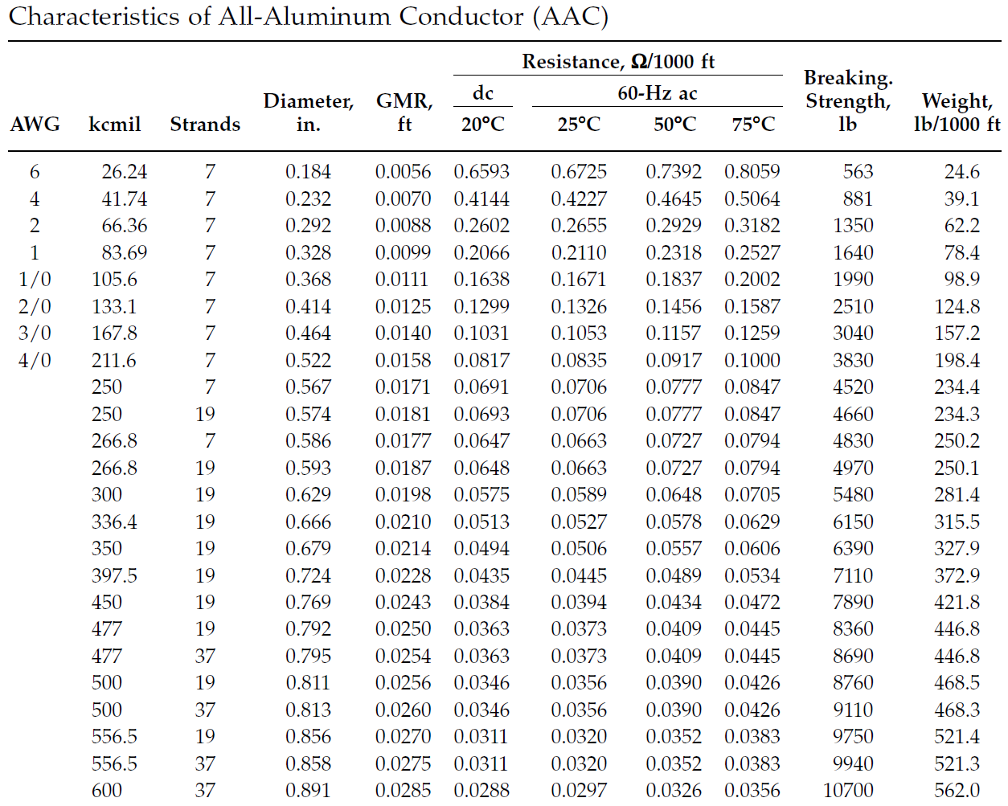
Ref: [1]

Slide 31
Conductors
American wire gage (AWG):
Smaller wires are normally referred to using the American wire gage (AWG) system. The gage is a numbering scheme that progresses geometrically.
A number 36 solid wire has a defined diameter of 0.005 in. (0.0127cm), and the largest size, a number 0000 (referred to as 4/0 and pronounced “four-ought”) solid wire has a 0.46-in. (1.17-cm) diameter.
The larger gage sizes in sequence of increasing conductor size are: 4, 3, 2, 1, 0 (1/0), 00 (2/0), 000 (3/0), 0000 (4/0).

Slide 32
Conductors
American wire gage (AWG):
Going to the next bigger size (smaller gage number)
increases the diameter by 1.1229. Some other useful rules are:
An increase of three gage sizes doubles the area and weight, and halves the dc resistance.
An increase of six gage sizes doubles the diameter.

Slide 33
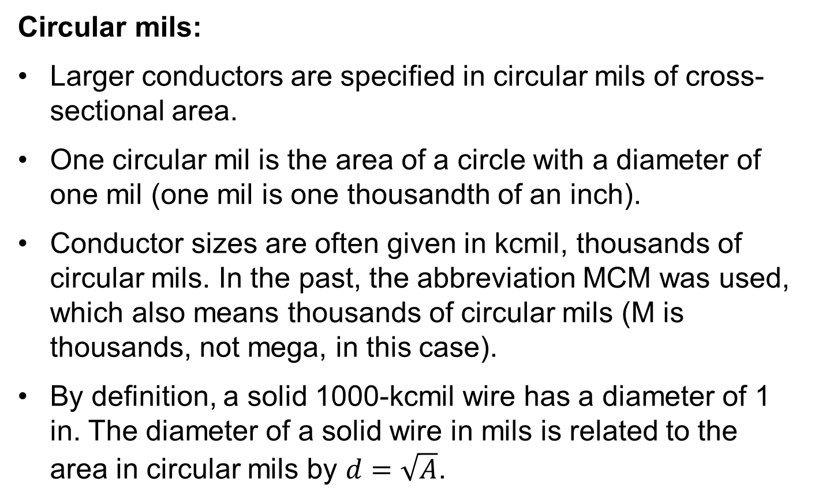
Conductors
Circular mils:
Larger conductors are specified in circular mils of cross-sectional area.
One circular mil is the area of a circle with a diameter of one mil (one mil is one thousandth of an inch).
Conductor sizes are often given in kcmil, thousands of circular mils. In the past, the abbreviation MCM was used, which also means thousands of circular mils (M is thousands, not mega, in this case).
By definition, a solid 1000-kcmil wire has a diameter of 1 in. The diameter of a solid wire in mils is related to the area in circular mils by $d=\sqrt{A}$.

Slide 34
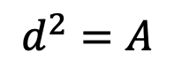
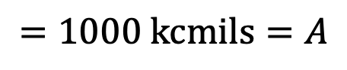
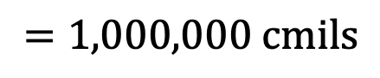
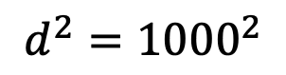
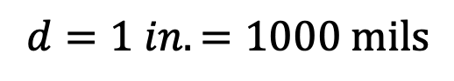
Conductors
Circular mils example: 1000 kcmil conductor has a diameter of 1 inch.
$$d^{2}=A$$
Diameter of mils squared
Area in circular mils
$$d=1 in.=1000 \text{mils}$$
$$d^{2}={1000}^{2}$$
$$=1,000,000 \text{cmils}$$
$$=\text{1000 }\text{kcmils}=A$$

Slide 35
Conductors
Circular mils:
Outside of America, most conductors are specified in mm². Some useful conversion relationships are:
1 kcmil = 1000 cmil = 785.4 X 10⁻⁶ in² = 0.5067 mm²

Slide 36
Conductors
Stranding:
Stranded conductors increase flexibility. A two-layer arrangement has seven wires
The cross-sectional area of a stranded conductor is the cross-sectional area of the metal, so a stranded conductor has a larger diameter than a solid conductor of the same area.
The strands category gives the number of strands. In the case of the ACSR there will be two numbers for instance 26/7, where 26 stands for the 26 aluminum strands and the 7 stands for the 7 strands of the steel core.

Slide 37
Conductors
Diameter and GMR:
The diameter is simply the physical diameter of the wire.
The geometric mean radius (GMR) quantifies a conductor’s internal inductance by definition, the GMR is the radius of an infinitely thin tube having the same internal inductance as the conductor out to a one-foot radius.

Slide 38
Conductors
Resistance:
The conductors have a dc resistance which is usually given at 20 degrees Celsius.
The conductors also have an ac resistance which is given at 25, 50 and 75 degrees Celsius. This is different than the dc resistance because of skin effect.

Slide 39
Conductors
Breaking strength and weight:
The breaking strength is the weight that the cable can sustain before it will become damaged.
Weight is the weight of the cable in a 1000ft segment.

Slide 40
Untransposed Distribution Lines

Slide 41
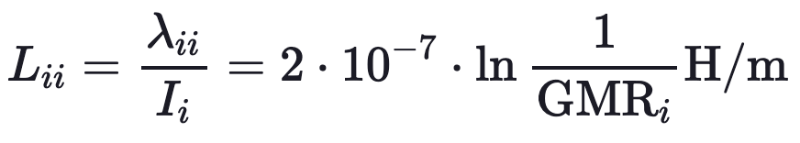
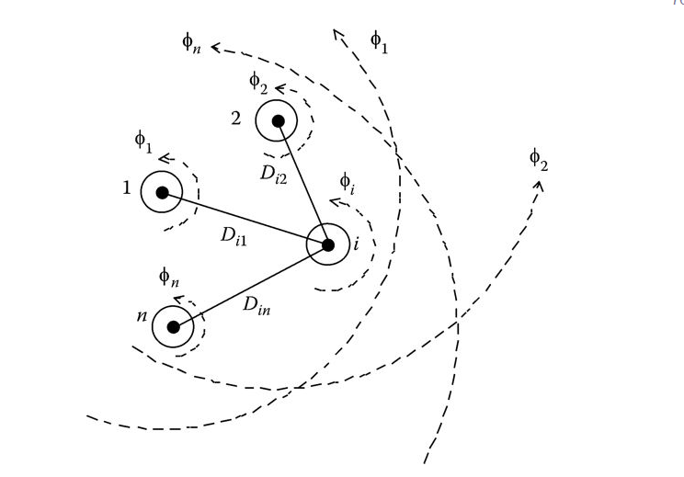
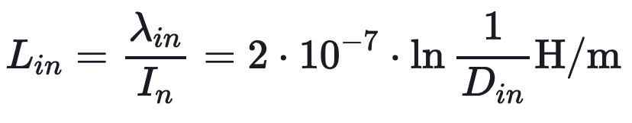
Untransposed Distribution Lines
Total flux linking conductor i:
Self inductance:
Mutual inductance:

Slide 42
Untransposed Distribution Lines
Because distribution systems consist of single-phase, two-phase, and untransposed three-phase lines serving unbalanced loads, it is necessary to retain the identity of the self- and mutual impedance terms of the conductors in addition to taking into account the ground return path for the unbalanced currents.

Slide 43
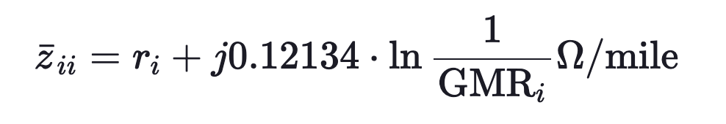
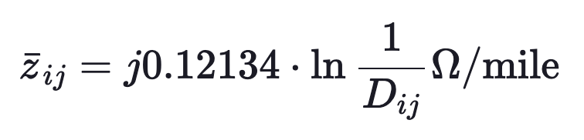
Untransposed Distribution Lines
To compute the self impedance we will use:
To compute the mutual impedance we will use:

Slide 44
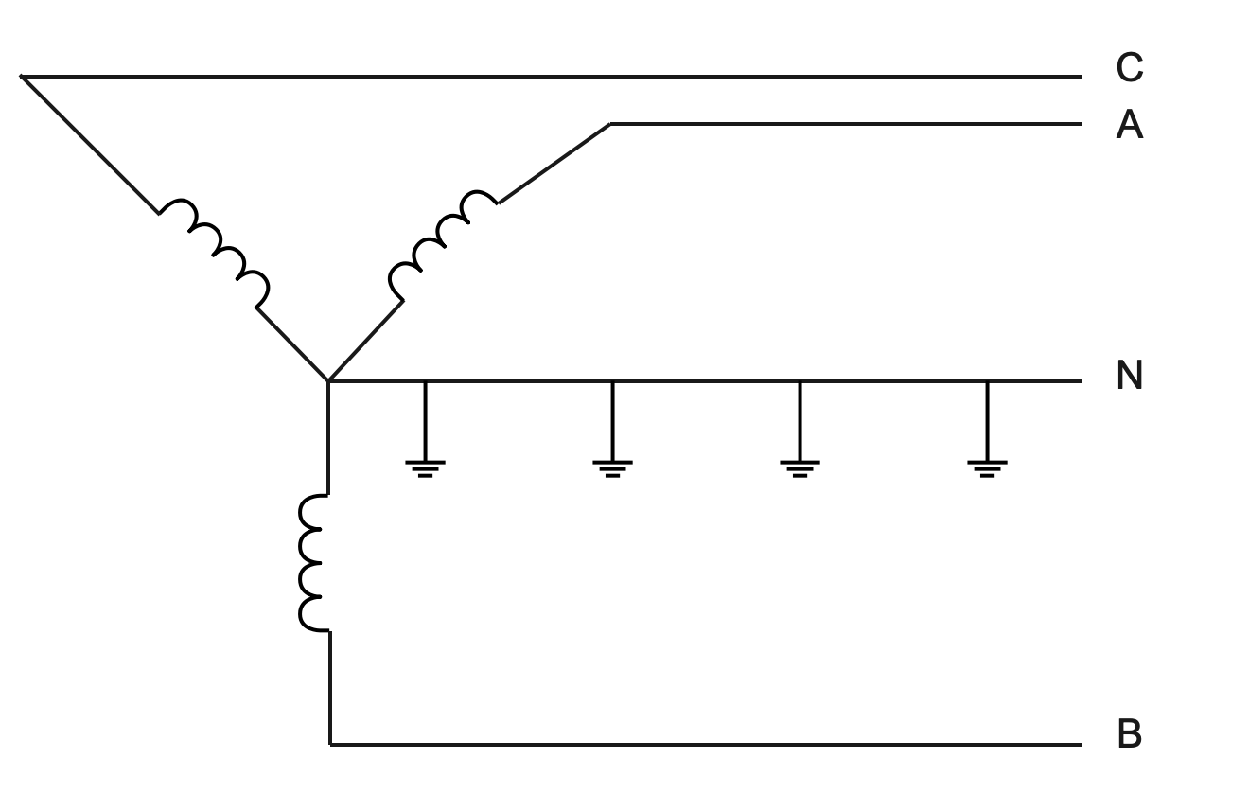
Untransposed Distribution Lines
Grounding on the primary distribution system (2400 volts to 34.5 kV) is usually either 4-wire multigrounded or delta.
A 4-wire multigrounded system, which is by far the most popular, means that the substation is grounded and a fourth wire, the neutral wire, is carried along with the phase wire and grounded periodically.
Multigrounded line with neutral grounded at several points

Slide 45
Untransposed Distribution Lines
Some utilities ground as little as four times per mile while others ground at every pole.
Sometimes the substation’s transformer is grounded through an impedance (approximately 1 ohm) in an effort to limit short circuit current levels.
Some of the more important advantages of a 4-wire multigrounded system (over a 3-wire delta) are:
High short circuit currents allowing effective overcurrent relaying practice.
Much cheaper for single-phase service, especially underground, since only one cable, bushing, switch, fuse, etc., needs to be used as compared to a delta system which needs 2 times as much equipment.
Lower rated arresters and lower rated BIL required.

Slide 46
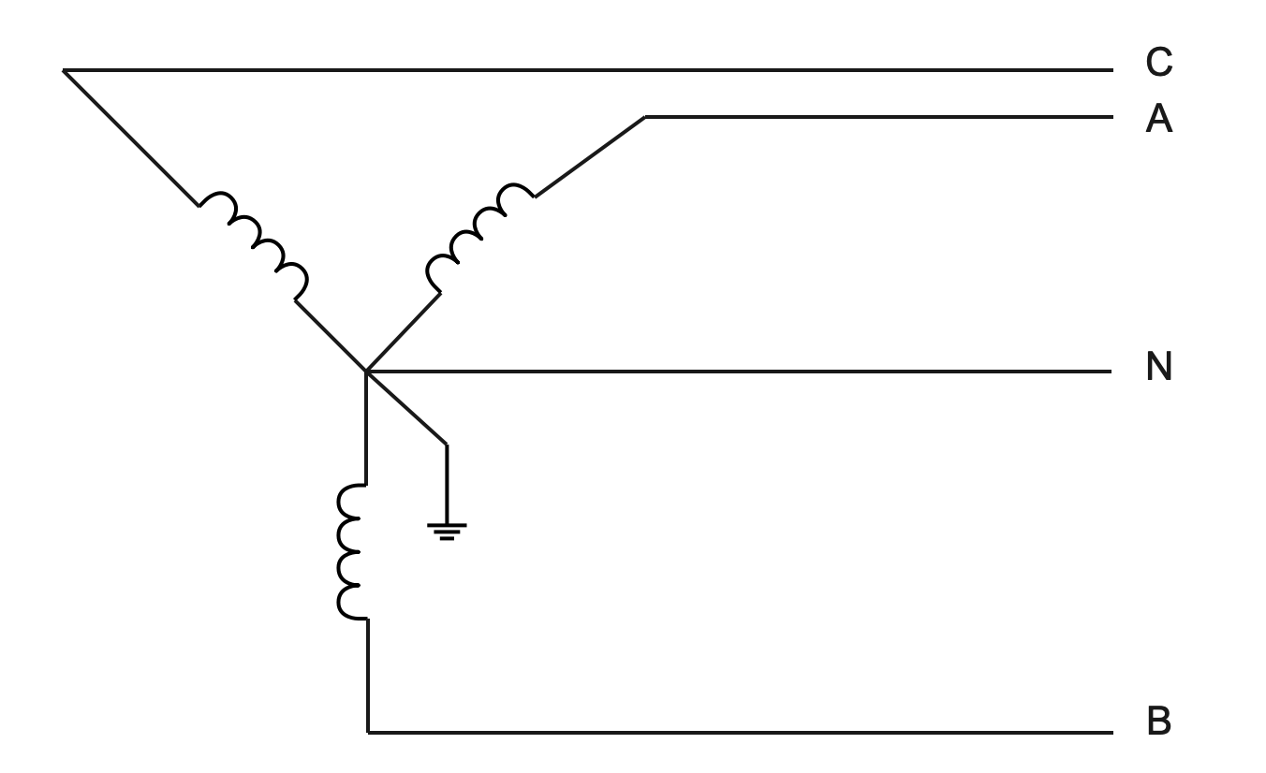
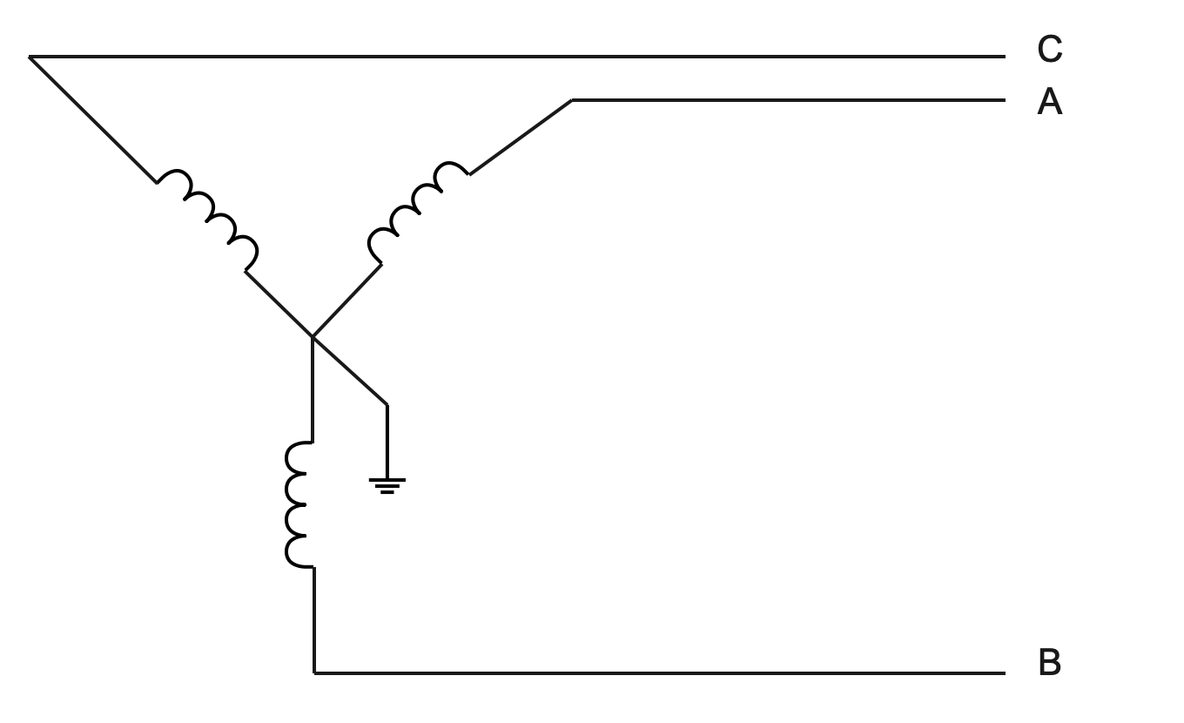
Untransposed Distribution Lines
Other common circuit configurations
Four-wire with neutral grounded at transformer only
Three-wire neutral grounded transformer

Slide 47
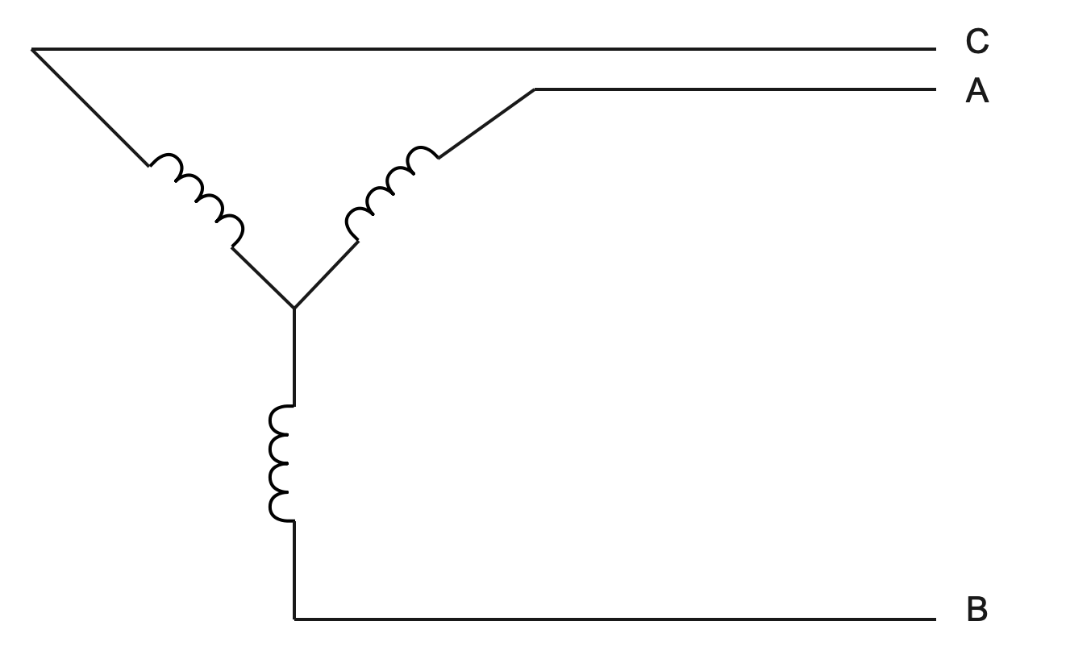
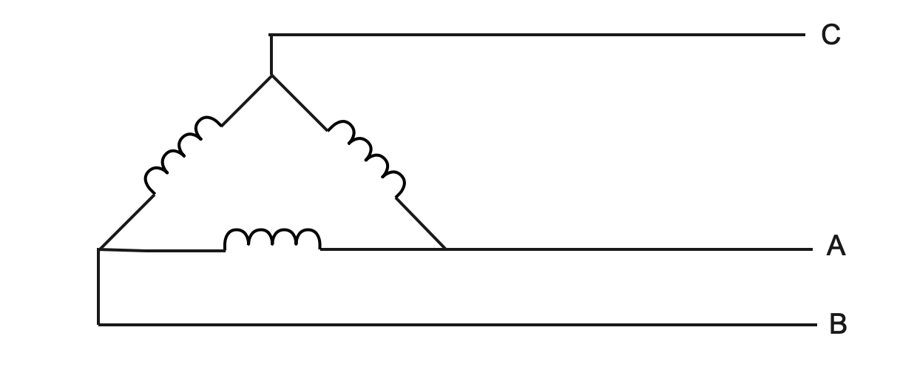
Untransposed Distribution Lines
Other common circuit configurations
Three-wire ungrounded
Three-wire fed from delta windings

Slide 48
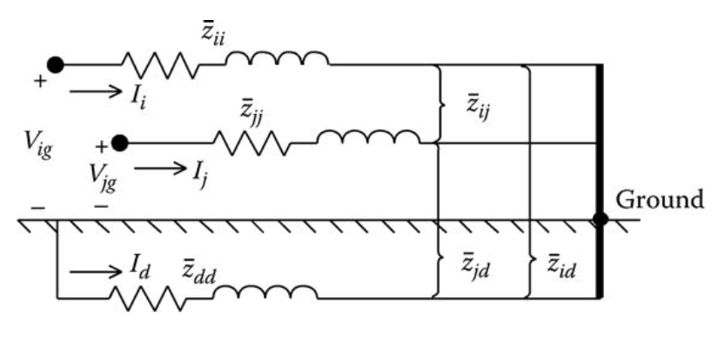
Untransposed Distribution Lines
The figure below illustrates a line consisting of two conductors (i and j) carrying currents (I_{i} and I_{j}) with the remote ends of the conductors tied to ground. A fictitious “dirt” conductor carrying current Id is used to represent the return path for the currents.

Slide 49
Untransposed Distribution Lines
We can use KVL to obtain:

Slide 50
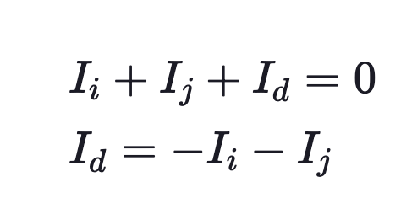
Untransposed Distribution Lines
Collecting in terms yields
Using KCL

Slide 51
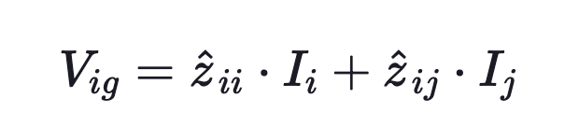
Untransposed Distribution Lines
Substituting
From which we get the general form

Slide 52
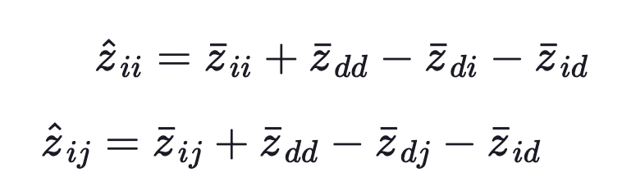
Untransposed Distribution Lines
Where

Slide 53
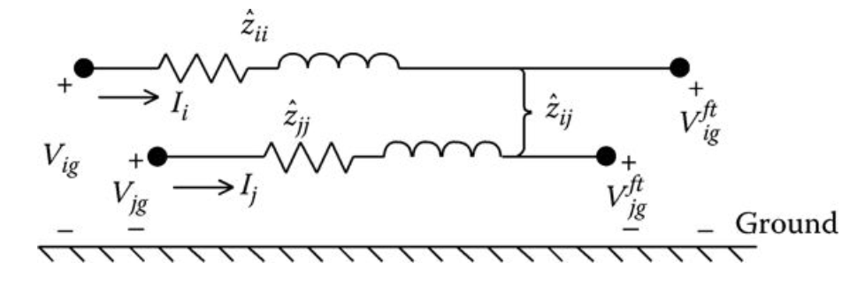
Untransposed Distribution Lines
In the previous equations the “hat” impedances are calculated. Note that in these two equations the effect of the ground return path is being “folded” into what will now be referred to as the “primitive” self- and mutual impedances of the line. The “equivalent primitive circuit” is shown in the figure below:

Slide 54
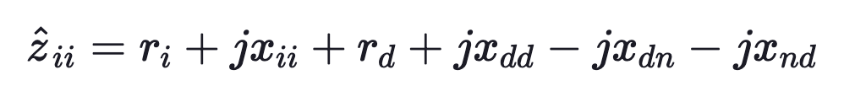
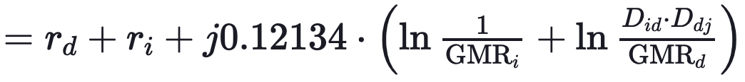
Untransposed Distribution Lines
These primitive self impedances are

Slide 55
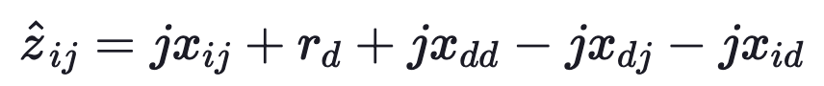
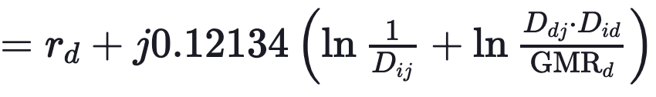
Untransposed Distribution Lines
These primitive mutual impedances are

Slide 56
Untransposed Distribution Lines
But how to we determine GMR_{d}, D_{id}, D_{di}, D_{jd}, and D_{dj}?
This is where Carson’s equations bail us out!!

Slide 57
Carson’s Equations

Slide 58
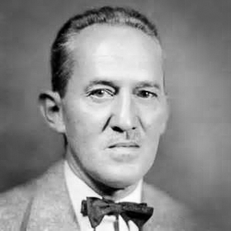
Carson’s Equations
John Renshaw Carson
John Renshaw Carson (June 28, 1886 - October 31, 1940) was a noted transmission theorist for early communications systems. He invented single-sideband modulation.
Carson was born in Pittsburgh, Pennsylvania, graduated from Princeton University in 1907 with a Bachelor of Science degree, and attended Massachusetts Institute of Technology 1907 -
1908 before returning to Princeton to receive his electrical engineering degree in 1909 and a Master of Science degree in 1912.

Slide 59
Carson’s Equations
In 1926, John Carson published a paper where he developed a set of equations for computing the self- and mutual impedances of lines taking into account the return path of current through ground.
Carson's approach was to represent a line with the conductors connected to a source at one end and grounded at the remote end.

Slide 60
Carson’s Equations
Since a distribution feeder is inherently unbalanced, the most accurate analysis should not make any assumptions regarding the spacing between conductors, conductor sizes, and transposition.
In Carson's 1926 paper, he developed a technique whereby the self- and mutual impedances for ncond overhead conductors can be determined.
The equations can also be applied to underground cables. In 1926, this technique was not met with a lot of enthusiasm because of the tedious calculations that would have to be done on the slide rule and by hand. With the advent of the digital computer, Carson's equations have now become widely used.

Slide 61
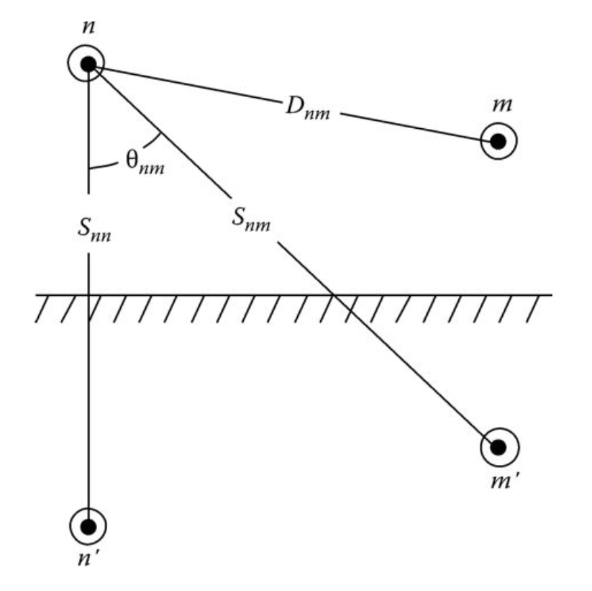
Carson’s Equations
The figure shown below shoes pair of conductors and their images:

Slide 62
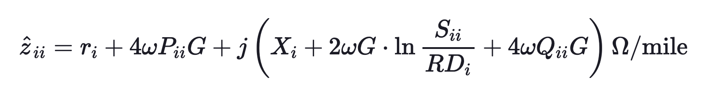
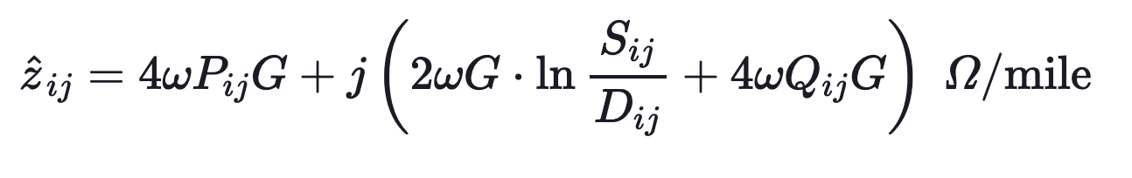
Carson’s Equations
Carson’s equations are:
Self Impedance
Mutual Impedance

Slide 63
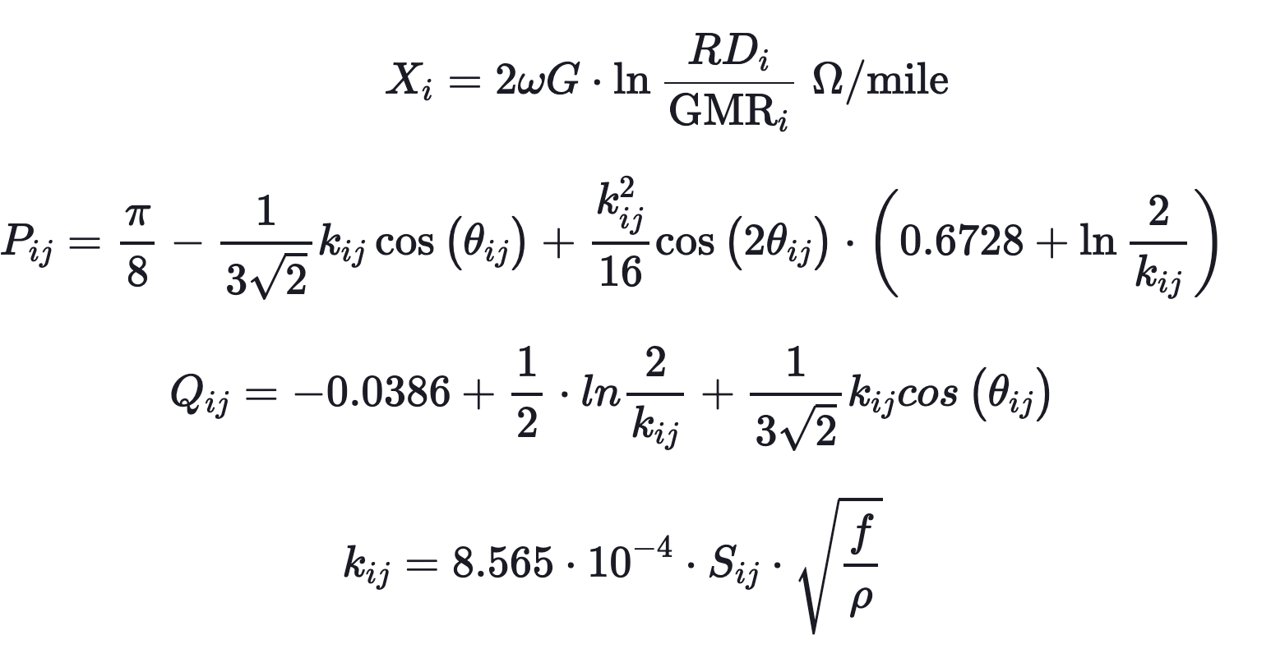
Carson’s Equations
and:

Slide 64
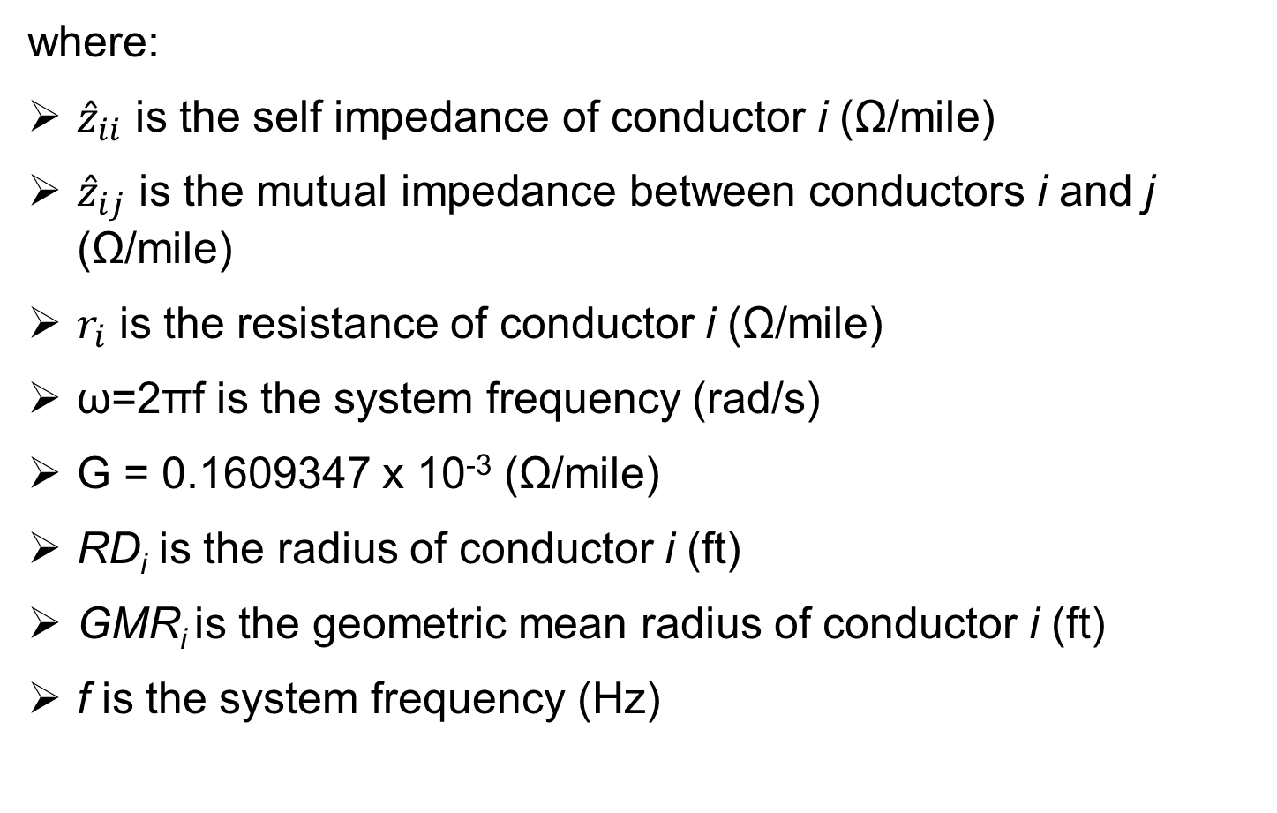
Carson’s Equations
where:
${\hat{z}}_{ii}$ is the self impedance of conductor i (Ω/mile)
${\hat{z}}_{ij}$ is the mutual impedance between conductors i and j (Ω/mile)
$r_{i}$ is the resistance of conductor i (Ω/mile)
ω=2πf is the system frequency (rad/s)
G = 0.1609347 x 10⁻³ (Ω/mile)
RD_{i} is the radius of conductor i (ft)
GMR_{i} is the geometric mean radius of conductor i (ft)
f is the system frequency (Hz)

Slide 65
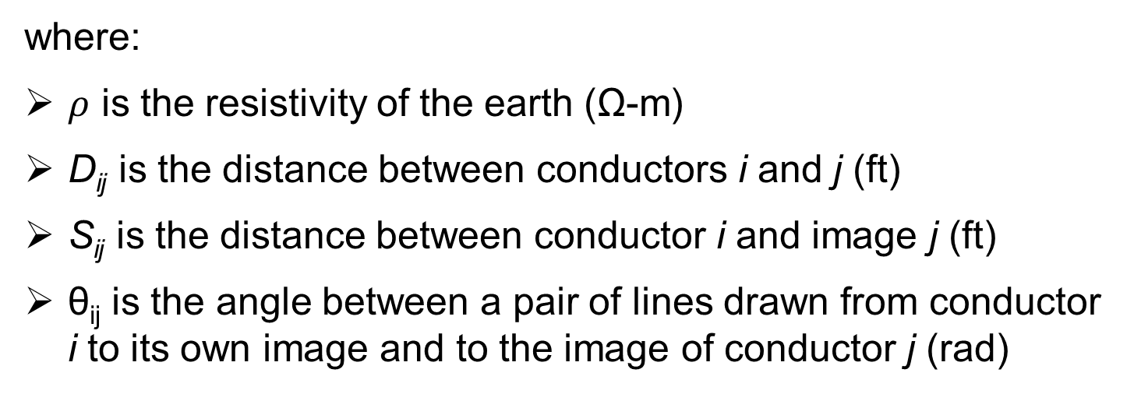
Carson’s Equations
where:
$ρ$ is the resistivity of the earth (Ω-m)
D_{ij} is the distance between conductors i and j (ft)
S_{ij} is the distance between conductor i and image j (ft)
θ_{ij} is the angle between a pair of lines drawn from conductor i to its own image and to the image of conductor j (rad)

Slide 66
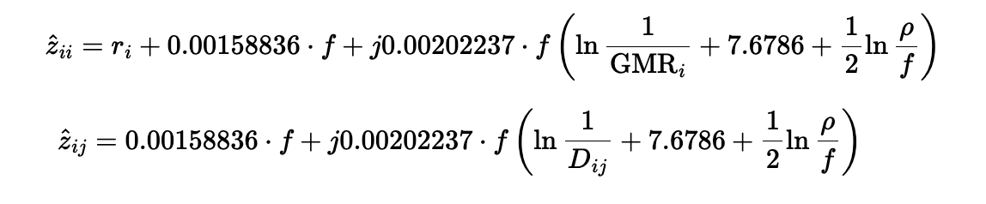
Carson’s Equations
These equations can be simplified so that the self and mutual impedances can be calculated in a much simpler fashion with only introducing a very small error. These equations are called the modified Carson’s equations

Slide 67
Reference Materials
[1] T. Short, “Electric Power Distribution Handbook”, ISBN 9781466598652, Published May 19, 2014 by CRC Press
[2] "File:ACSR and ACCC.JPG" by Dave Bryant is licensed under CC BY-SA 3.0. To view a copy of this license, visit https://creativecommons.org/licenses/by-sa/3.0/?ref=openverse.
[3] Author: Wongm, Wikimedia username: Wongm
URL: http://commons.wikimedia.org/wiki/User:Wongm

